Slide 1
The Zen of Cybersecurity
Unit 1.1
Cybersecurity Boot Camp |

Slide 2
Quick Introduction!
Name
Where From?
Background (Career, Education, Interests)
Why are you here?

Slide 3
Instructor = … ?
YOUR NAME HERE
INFO BULLET #1
INFO BULLET #2
Over X years in cybersecurity (with plenty of experience being a n00b at it.)
INFO BULLET #3
INFO BULLET #4
INFO BULLET #5
YOUR PHOTO
GOES HERE

Slide 4
Things I’ve Worked On…
Cool Security Projects You’ve Worked on Goes Here

Slide 5
The Rising Cyber Threat

Slide 6
Why is cybersecurity such a hot skill these days?

Slide 7




Reason 1: Explosive Growth in Dependence on IT
Nearly every personal, social, and commercial aspect of our lives today makes contact with vulnerable IT infrastructure.

Slide 8

Reason 2: More Users (Targets) on Connected Devices
More people than ever are logged onto connected devices – often for the majority of their waking (and sleeping) hours.

Slide 9
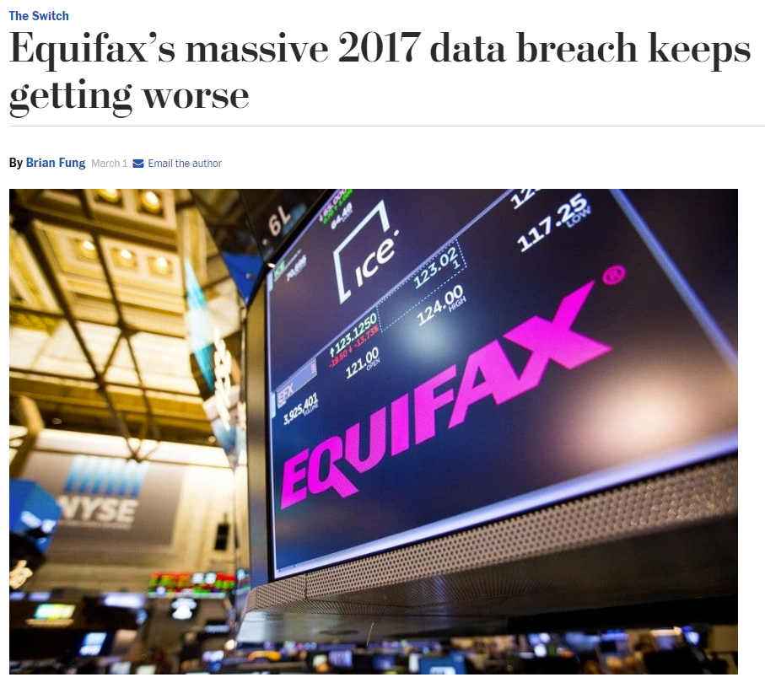
Reason 3: Better Tools for Bigger Damage
Cyber attacks today are becoming more sophisticated, aggressive, and disruptive than ever before.

Slide 10
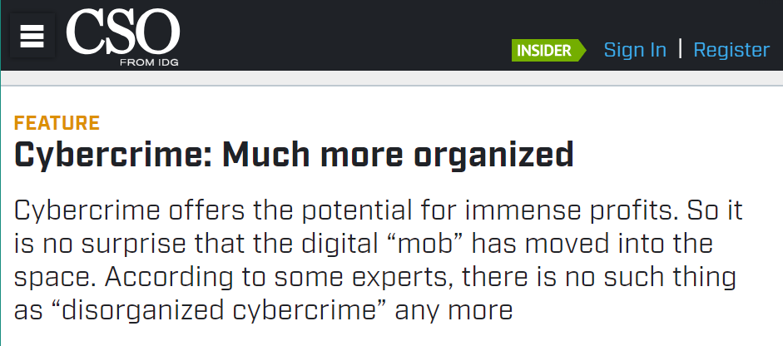
Reason 4: Significant Investment by Bad Actors
Where once the field of cybercrime was populated by individual “lone hackers”; today it’s become a focal point for organized crime, nation states, and private enterprises.

Slide 11
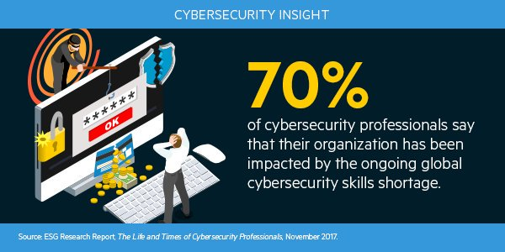
Reason 5: Dire Shortage of Skilled Professionals
According to studies by (ISC)², there will be over 1.5 million unfilled cybersecurity positions by 2020.

Slide 12
Defining Cybersecurity

Slide 13
What is the first thing you think of when you hear the term: “cybersecurity?”

Slide 14

Everyone’s First Thought
Don’t mind me. I’m just checking email.
“Hackers”

Slide 15
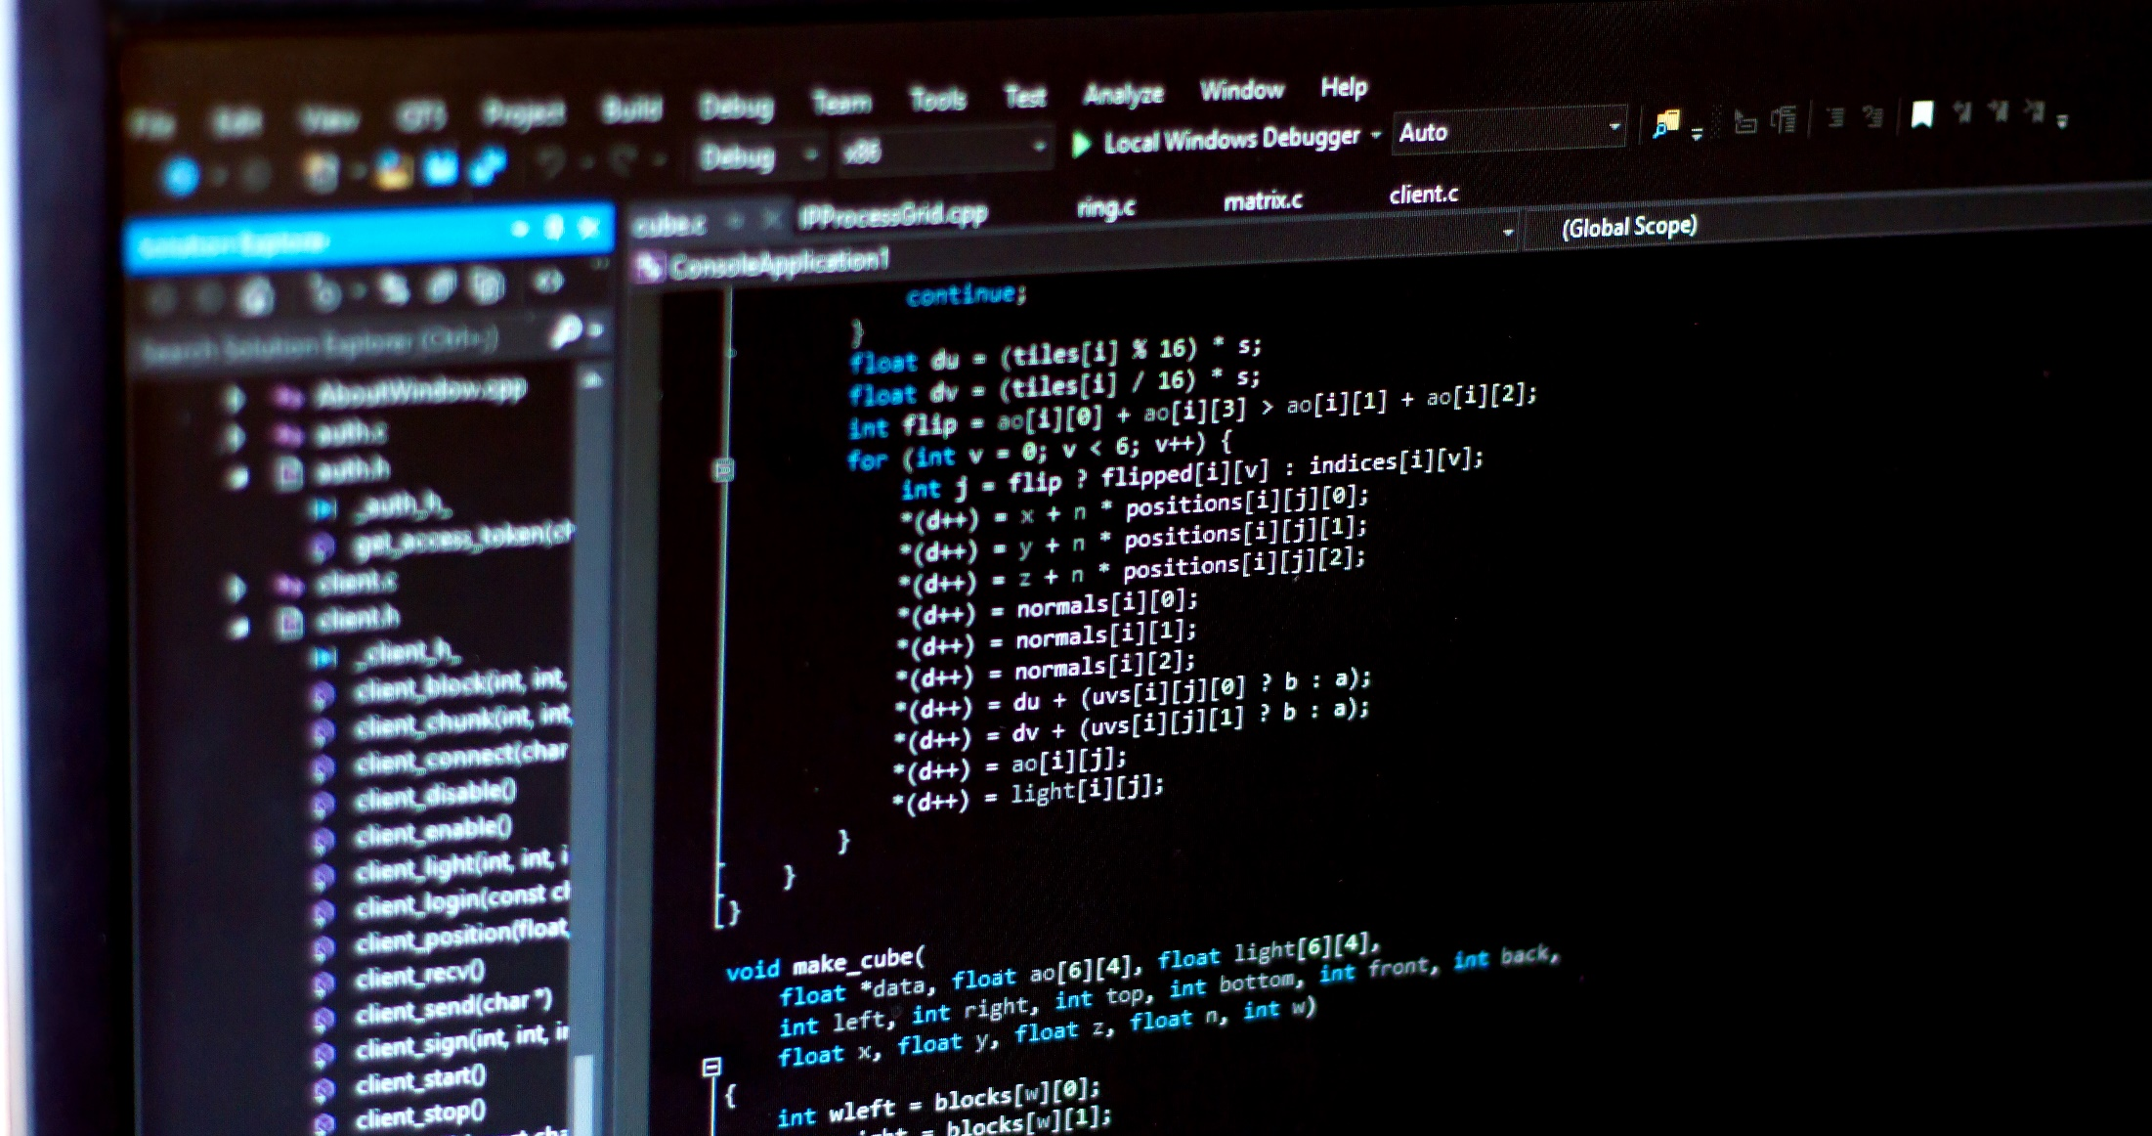
Everyone’s Second Thought
P.S. This is not security related at all.
“Complex Code”

Slide 16
But cybersecurity isn’t about
hackers and code.

Slide 17
What Cybersecurity is Really About
Assessing Threats
and Mitigating Risks

Slide 18
Assessing Threats

Slide 19

A Harmless USB?
Let’s say we found a USB drive laying on the ground…

Slide 20
A Harmless USB?
How much of a threat could this really be?

Slide 21
A Harmless USB?
Let’s find out.

Slide 22
Activity: The Case of the Crazy USB (5 Minutes)
Quick Activity:
Turn to the person next to you and discuss what just happened.
How might it be that a USB drive was able to immediately execute running code?
Why didn’t our computer stop the drive from running?
How might we defend against malevolent USBs like this?

Slide 23
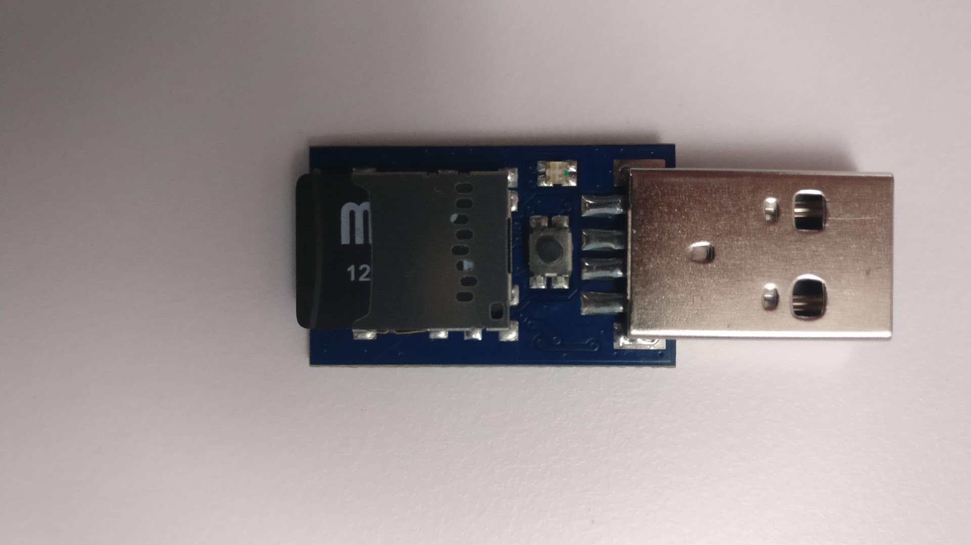
A Harmless USB?
USB sheath masks that it’s not a drive at all… but actually a mini keylogger with a program attached. When connected, our computer registers it as a keyboard allowing it to kick-off without restriction.
Like most threats, their appearances are deceptively safe-seeming.

Slide 24
A Harmless USB?
USB sheath masks that it’s not a drive at all… but actually a mini keylogger with a program attached. When connected, our computer registers it as a keyboard allowing it to kick-off without restriction.
Keylogger
Stored program
Like most threats, their appearances are deceptively safe-seeming.

Slide 25
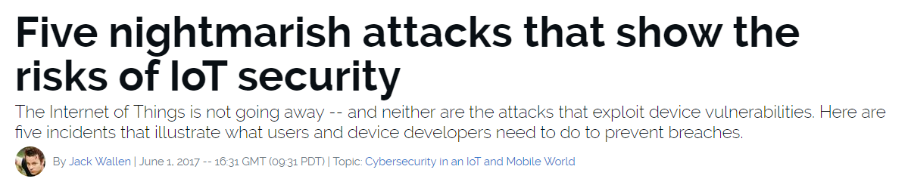
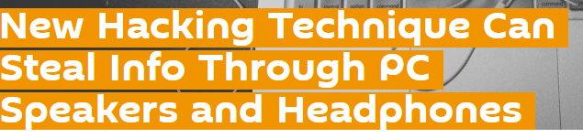
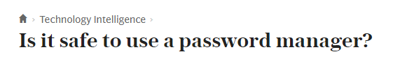
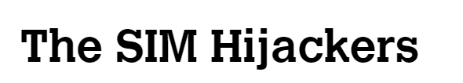
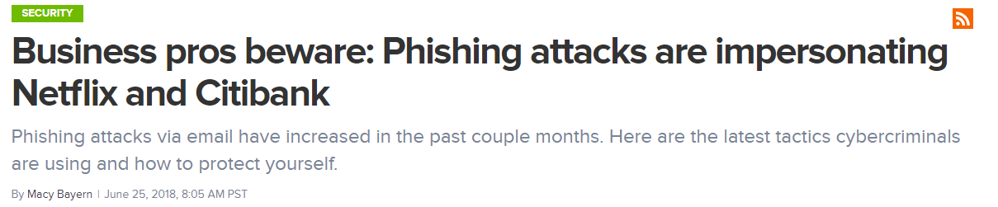
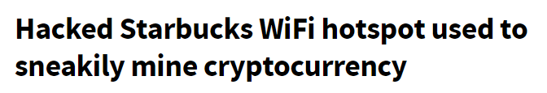
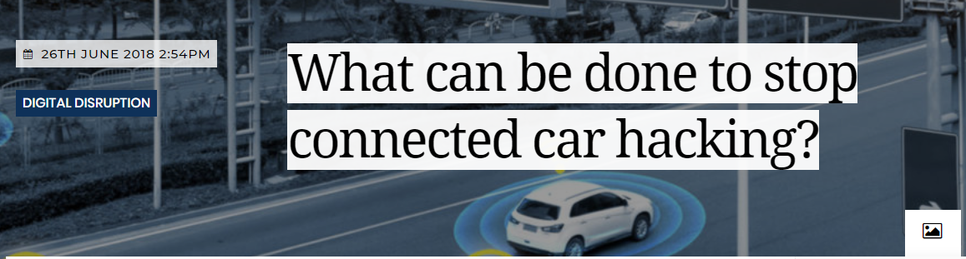
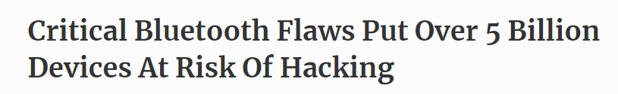
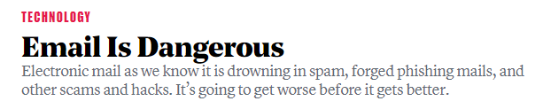
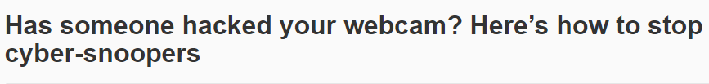
Know Thy Threats
To the experienced cybersecurity professional,
risks are everywhere.

Slide 26
Mitigating Risks

Slide 27

The (Old) Castle Model of Security
Historically, organizations viewed cybersecurity from the lens of the “castle model.” Walls were built and “managing risk” meant keeping the bad guys out.

Slide 28
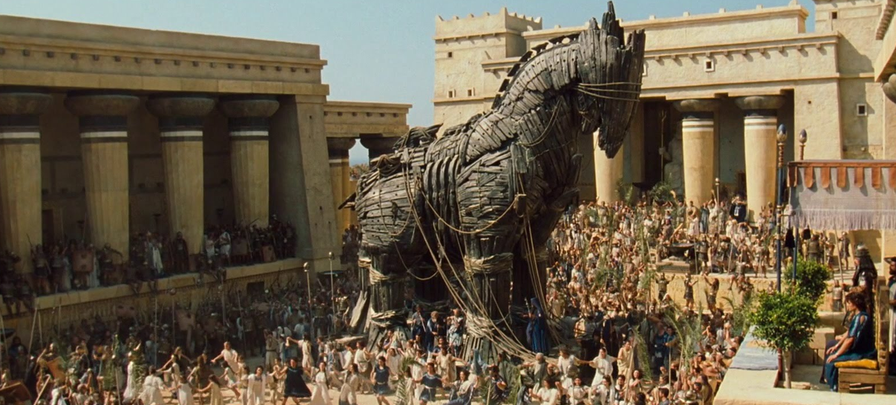
The (New) Assumed Breach Model of Security
Today, security professionals operate in a world where breach is assumed, and the risks associated with such events also need to be mitigated.

Slide 29

The Tools to Mitigate Risk
Security Professionals must rely on a fleet of technologies, processes, and practices to mitigate risks from multiple channels of attack.

Slide 30
Course Overview

Slide 31
Our Future Toolbelt
Our Goals
Threat Assessment
Risk Mitigation
Our Tools
Network Security
Web Security
OS Security
Cryptography
Penetration Testing
Incident Response
Vulnerability Assessment
Security Policy
Risk Analysis
Compliance Strategy
Operational Security
UNIX Command Line
Python Programming
Packet Tracer
Wireshark
Kali Linux
Nmap
Nessus
Metasploit
Burp Suite
SIEMs
And More

Slide 32
Daily Routine
For each class we’ll run through the following:
Set Objectives
Brief Background Lecture
Instructor Demonstrations
Thought Exercises
In-Class Skill Builders
Project Work

Slide 33
Daily Routine
For each class we’ll run through the following:
Set Objectives
Brief Background Lecture
Instructor Demonstrations
Thought Exercises
In-Class Skill Builders
Project Work
The Super Important Stuff!!!
i.e. Always be Doing!

Slide 34
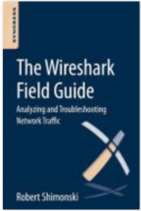





Curriculum At-A-Glance
Weeks 1-7: Intro to Computing, Networking, and Programming We’ll begin with an introduction to the Command Line, Python Programming, Cryptography, Computer Networks, and Traffic Analysis.
Weeks 8: Test Prep #1 (Network+)
Weeks 9-13: Systems, Network, and Browser Security
We’ll then dive into the attack and defense of networks, web applications, and operating systems. Here we’ll learn a fleet of ethnical hacking strategies.
Weeks 14-17: Penetration Testing and Threat Hunting
We’ll cap our work in offensive security by focusing on penetration testing. We’ll work extensively with tools like Kali Linux, Metasploit, Nmap, and Burpsuite.
Weeks 18-21: Strategy, Governance, and Risk Analysis
We’ll then dovetail into topics like incident response, policy, compliance, threat modelling, enterprise strategy, and operational security.
Weeks 22: Test Prep #2 (Security+)
Weeks 23-24: Special Topics + Final Projects

Slide 35
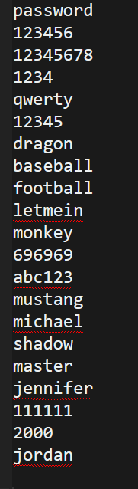
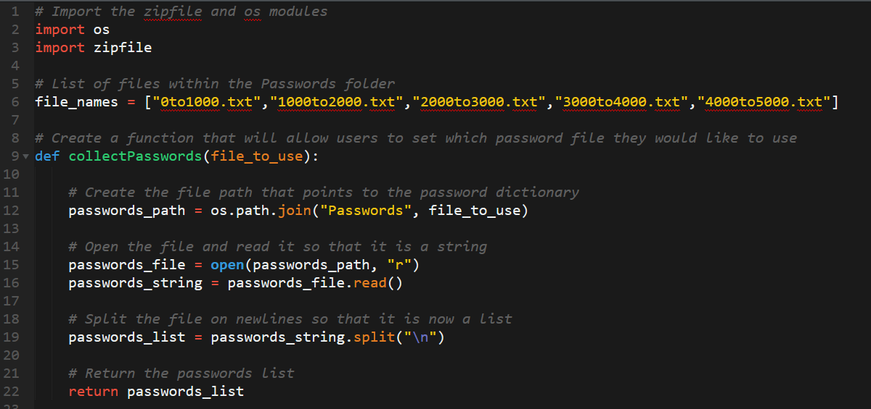
Example Activity: Build A Password Cracker
We’ll learn to write Python code that breaks into password encrypted files by brute forcing tens of thousands of common passwords.

Slide 36
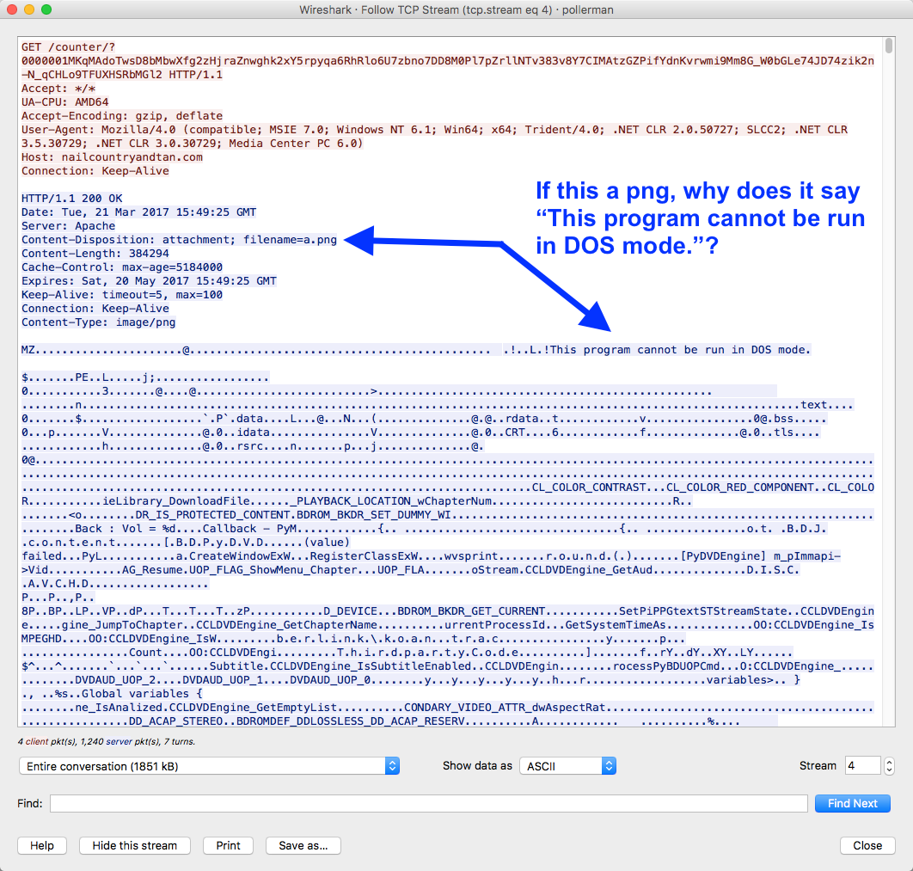
Example Activity: Analyze Network Traffic for Malware
We’ll learn to process complex network traffic logs to find evidence of malware being sent across networks.

Slide 37

Example Activity: Encryption / Decryption Systems
Plaintext
Ciphertext
Encryption
Readable
Message,
File, or Data
Encrypted Message, File, or Data
Key(s)
Decryption
We’ll learn how modern cryptography works and learn how historic methods of encryption could be broken through simple means.

Slide 38
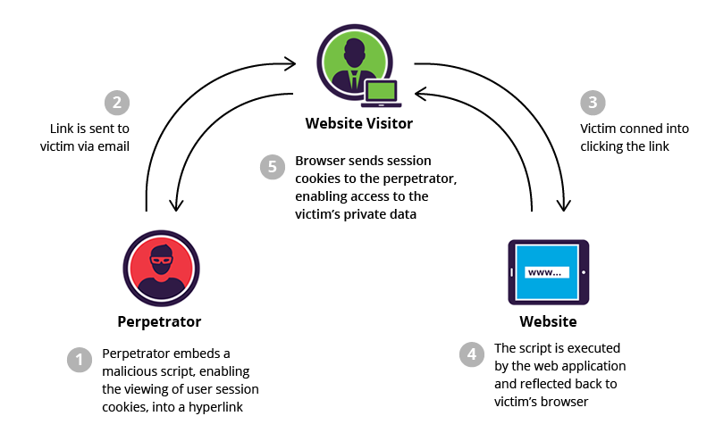
Example Activity: Web Application Hardening
We’ll learn how web applications can be defended against the most common attacks.

Slide 39
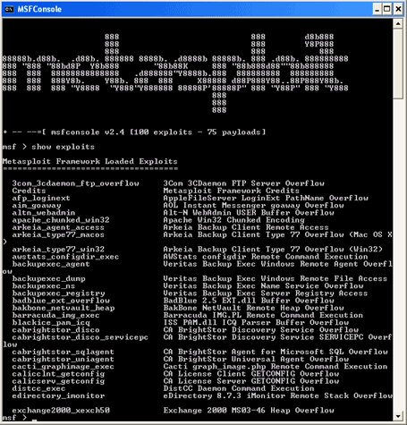
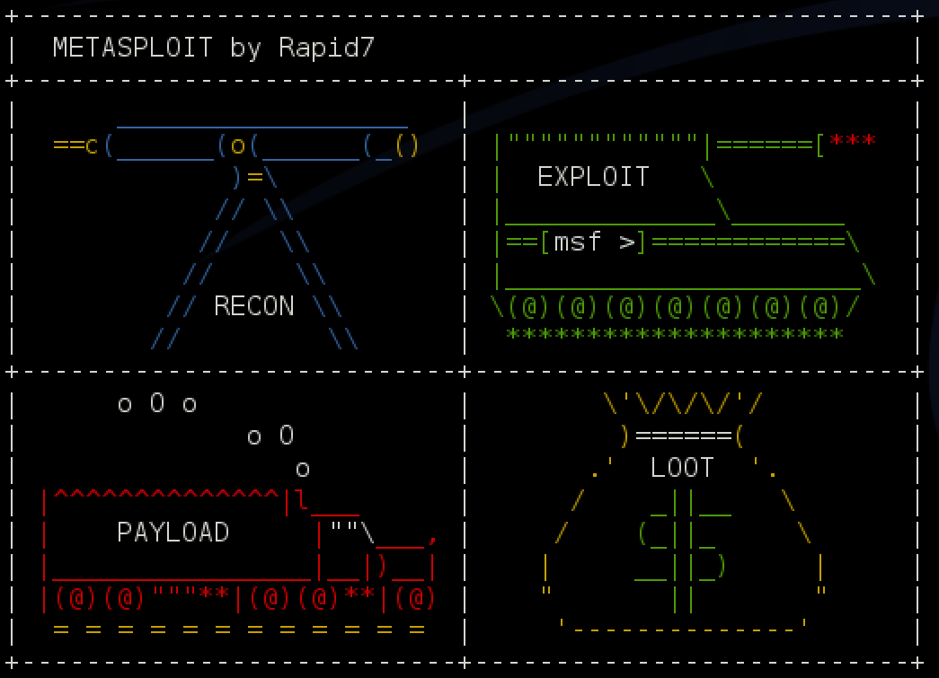
Example Activity: Identify Vulnerabilities in Unpatched Systems
We’ll learn to use tools like Kali Linux, Nmap, and Metasploit to run penetration tests on operating systems to identify known exploits.

Slide 40
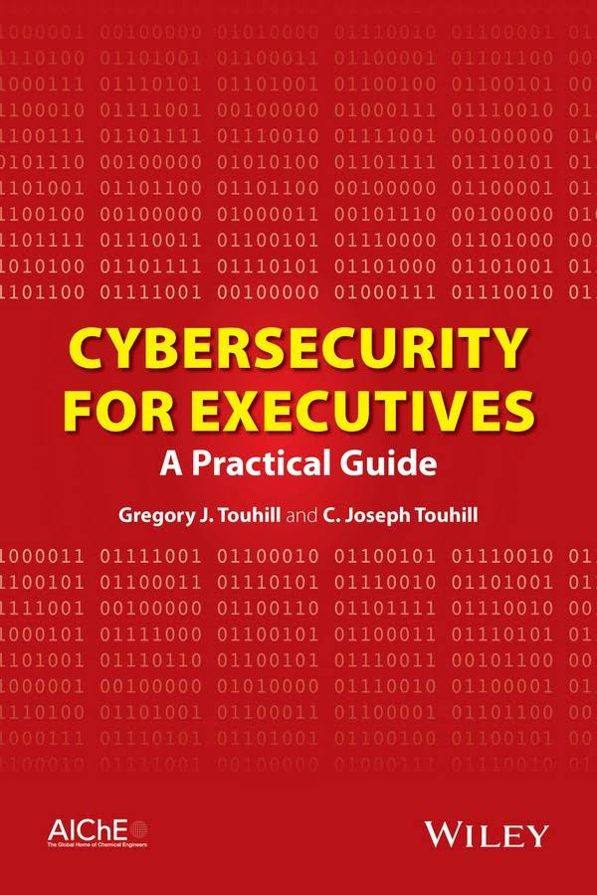
Example Activity: Cybersecurity Policy and Strategy
Lastly, we’ll learn how to talk about cybersecurity risks, strategy, and policy in a way that extends away from the laptop and into the C-Suite.

Slide 41
Helpful Tips

Slide 42

Tip #1: Embrace Your Inner Toddler
This should be you.

Slide 43

Tip #2: Brace Yourself for Doubt, Challenge, and Confusion
You will feel this way. Remember, it’s part of the process!

Slide 44
Tip #2: Brace Yourself for Doubt, Challenge, and Confusion
“You can’t tell whether you’re learning something when you’re learning it—in fact, learning feels a lot more like frustration.”
“What I’ve learned is that during this period of frustration is actually when people improve the most, and their improvements are usually obvious to an outsider. If you feel frustrated while trying to understand new concepts, try to remember that it might not feel like it, but you’re probably rapidly expanding your knowledge.”
Jeff Dickey, Author and Software Developer

Slide 45
Tip #3: Relish the Novice Experience
You’re a beginner! Enjoy the lightbulb moments.

Slide 46
Tip #4: Find a Community Now!
You and your class are in this together.
Use each other for help!

Slide 47

Tip #5: Put in the Hours (And the Effort)
There is no “magic pill”. You’ve got to put in the hours!

Slide 48

Tip #6: Celebrate Your Successes!
This class will challenge you.
Celebrate every
win along the way!

Slide 49
It’s time for a group activity!

Slide 50
Form a group of 3-4 students. (Psst… They shouldn’t be someone right next to you)

Slide 51
Break!

Slide 52
Security Challenge #1
Attacking the Wall

Slide 53
Time for a
Security Challenge
In this security challenge, you and your group will play the role of security professionals tasked with
handling a real-world situation.

Slide 54

We met on
BondingThroughBitcoin.com!
Congratulations!
You and your team have just been hired by a supremely successful startup that runs a Bitcoin Dating Exchange.
(We know. It’s kind of crazy).

Slide 55

Secure my code? Nah...
While their founding team is brilliant, like many startups,
they don’t know the first thing about security.

Slide 56

They have just handed you a bucketload of cash to solve their single most pressing problem.

Slide 57
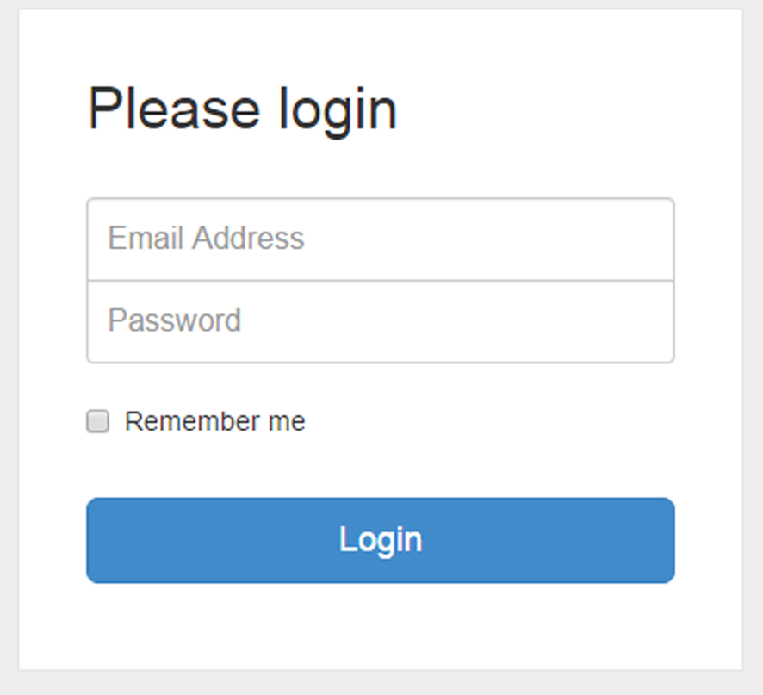
Hack Me!
Their login process is totally and completely insecure.

Slide 58

Not even a firewall???
Come on. This is too easy…
Today, hackers are routinely logging in as users (and, worse yet, as administrators) and gaining access to company data and financial assets.

Slide 59
Activity: Attacking The Wall (15 Minutes)
Assignment:
With your group, develop a list of 15 different ways that a malicious actor could penetrate the system and login as a user or administrator.
With each method, be prepared to describe:
Who (or what) is the initial target?
How would the actor implement the attack?
Be Prepared to Share!

Slide 60
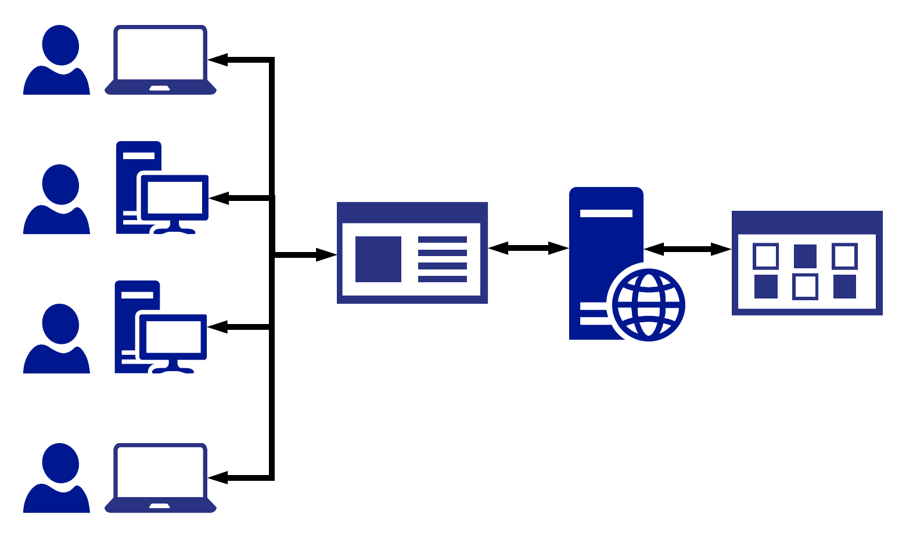
Activity: Attacking The Wall (15 Minutes)
Web Logins 101
Web Login
Server
Data
We’ll spend a lot more time talking about web logins later in this course, but for now use this diagram to guide your thoughts.
Users and Admins

Slide 61
Activity: Attacking The Wall (15 Minutes)
Web Login
Server
Data
Defend this with your life!
Users and Admins

Slide 62
Security Challenge #1
Attacking the Wall (Analyzed)

Slide 63
Step 1: Assess the Targets

Slide 64
Step 1: Assess the Targets
Which are targets?
Web Login
Server
Data
Users and Admins

Slide 65
Step 1: Assess the Targets
Lots of Targets
Web Login
Server
Data
In this case, an attacker could target EVERY node along the chain.
Users and Admins

Slide 66
Step 1: Assess the Targets
User Attacks
Web Login
Server
Data
Users are subject to a variety of social engineering tactics.
Users and Admins

Slide 67
Step 1: Assess the Targets
Web Attacks
Web Login
Server
Data
Websites are vulnerable to a broad set of code related attacks.
Users and Admins

Slide 68
Step 1: Assess the Targets
Server Attacks
Web Login
Server
Data
Servers are vulnerable to a host of operating system exploits and attacks.
Users and Admins

Slide 69
Step 1: Assess the Targets
Data Center Attacks
Web Login
Server
Data
Data Centers are vulnerable to physical and cloud attacks.
Users and Admins

Slide 70
Step 2: Define Attack Strategies

Slide 71
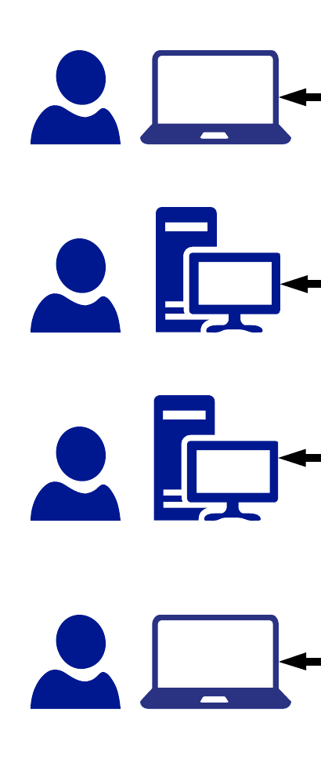
Step 2: Define Attack Strategies
Let’s start with user attacks

Slide 72
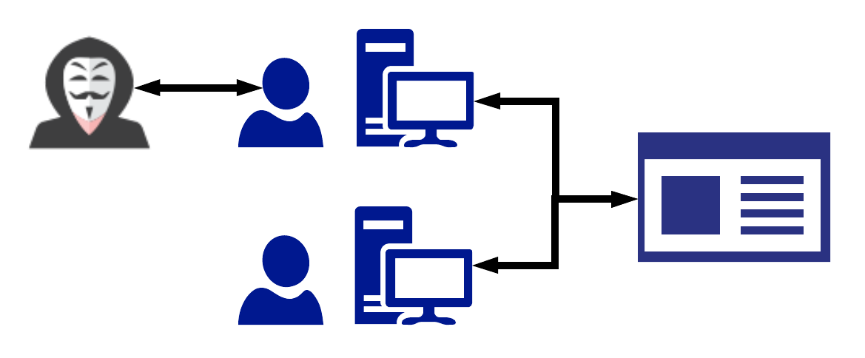
Step 2: Define Attack Strategies
Fake Admin
Attack Option #1:
A hacker could ask users for their credentials by falsely pretending to be an administrator (social engineering).

Slide 73
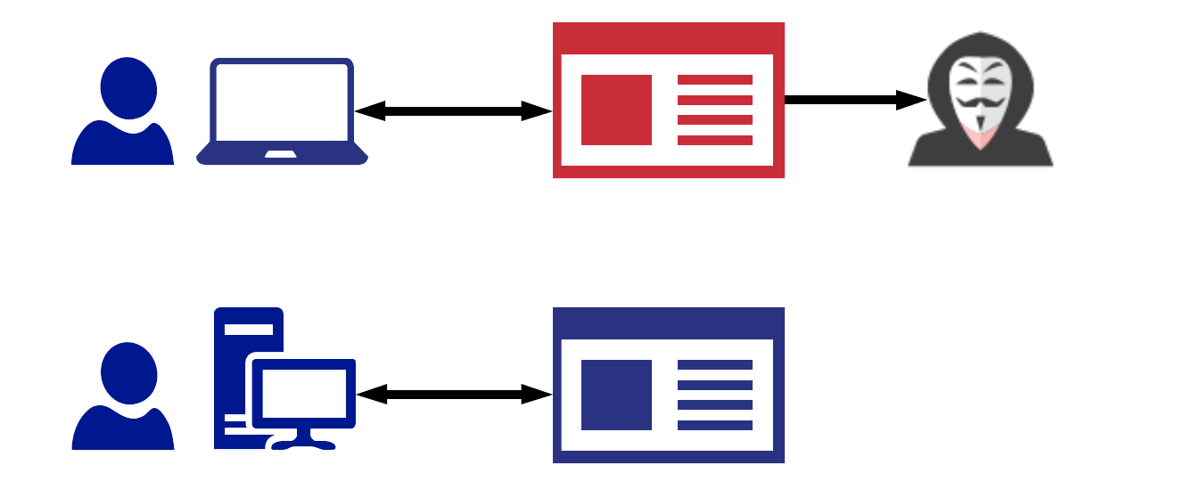
Step 2: Define Attack Strategies
Fake Login
Attack Option #2:
A hacker could attempt a phishing attack where users are redirected to fake login pages to capture user credentials.

Slide 74
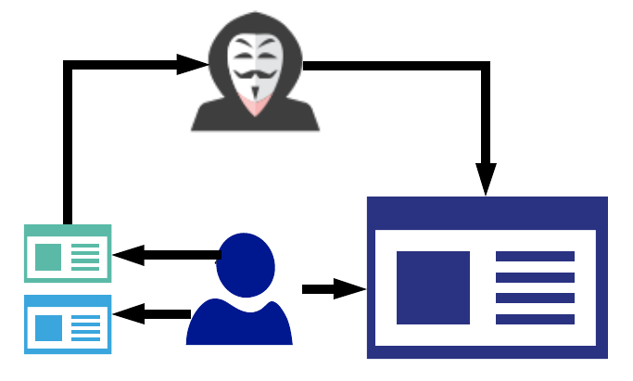
Step 2: Define Attack Strategies
Recycled Password
Attack Option #3:
A hacker could find users’ login and password information from other websites (credential reuse).

Slide 75
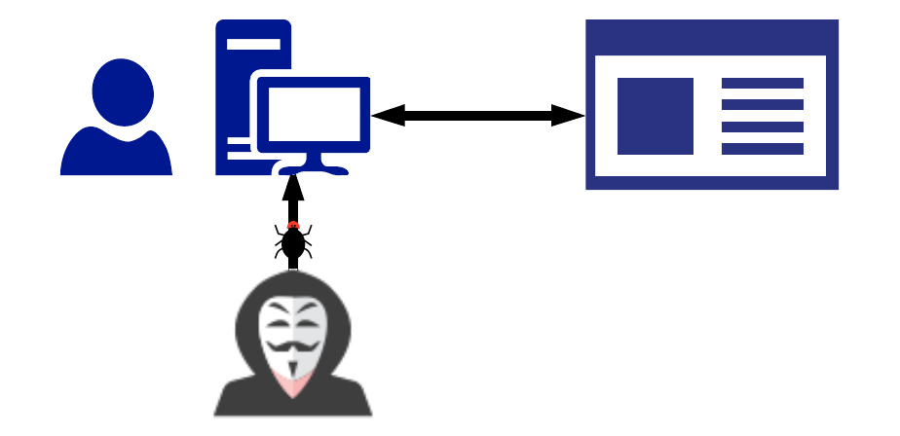
Step 2: Define Attack Strategies
Malware
Attack Option #4:
A hacker could deploy malware such as spyware or keyloggers to capture daily user activity.

Slide 76
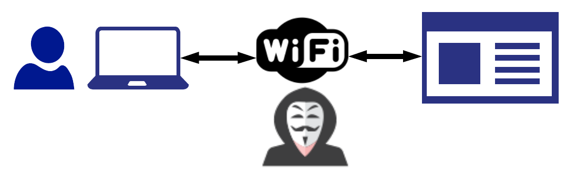
Step 2: Define Attack Strategies
Shady Hotspot
Attack Option #5:
A hacker could create a man-in-the-middle attack by providing a free Wi-Fi hotspot to capture user credentials.

Slide 77
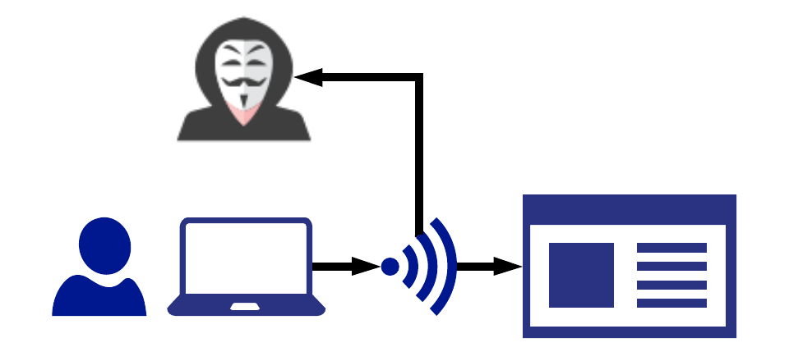
Step 2: Define Attack Strategies
Packet Sniff
Attack Option #6:
A hacker could sniff packet traffic across insecure
wireless networks such as a café or restaurant.

Slide 78
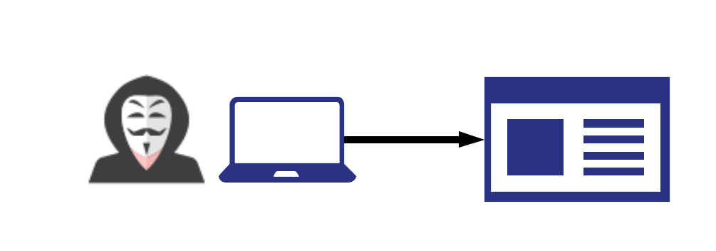
Step 2: Define Attack Strategies
Stolen Laptop
Attack Option #7:
A hacker could simply steal a computer and use the saved credentials to login.

Slide 79

Step 2: Define Attack Strategies
Next up,
website attacks

Slide 80
Step 2: Define Attack Strategies
Username: bob@bbb.com Password: Love
Username: bob@bbb.com Password: Love123
Username: bob@bbb.com Password: Love123!
Username: bob@bbb.com Password: L@ve123!
Password Dictionary
Attack Option #8:
A hacker could utilize a Brute Force Attack to attempt a continual battery of username and password combinations.

Slide 81
Step 2: Define Attack Strategies
Username: uName = getRequestString("username"); uPass = getRequestString("userpassword"); sql = 'SELECT * FROM Users WHERE Name ="' + uName + '" AND Pass ="' + uPass + '"'
Code Injection
Attack Option #9:
A hacker could utilize a Code Injection Attack in which malicious code is directly injected into the username or password field.

Slide 82
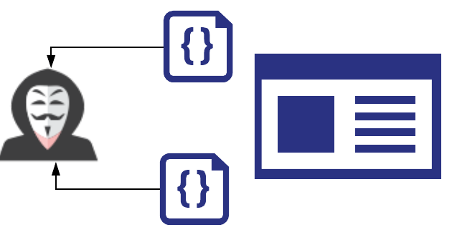
Step 2: Define Attack Strategies
Code Exploitation
Attack Option #10:
A hacker could exploit faulty session management.
This occurs when developers incorrectly implement code for maintaining login and logouts.

Slide 83

Step 2: Define Attack Strategies
Next up,
server attacks

Slide 84
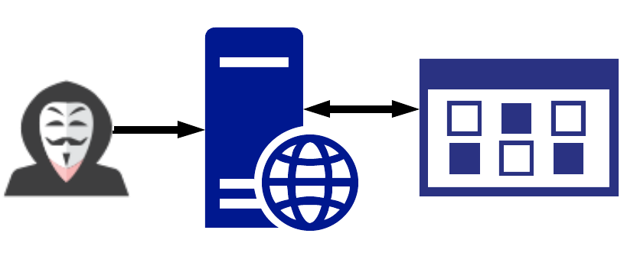
Step 2: Define Attack Strategies
Vulnerable OS
Attack Option #11:
Servers, which run operating systems like Windows and Linux, are subject to OS exploits when incorrectly patched.

Slide 85
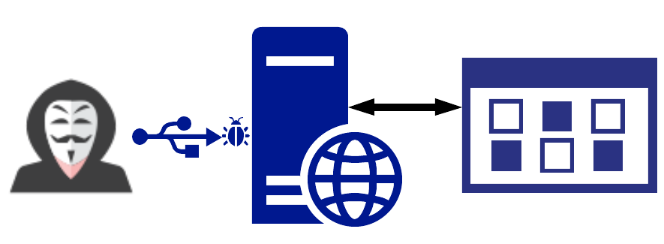
Step 2: Define Attack Strategies
Malicious Software
Attack Option #12:
Malicious software can be directly loaded onto server by USB or other peripheral devices.

Slide 86

Step 2: Define Attack Strategies
Finally,
Database attacks

Slide 87
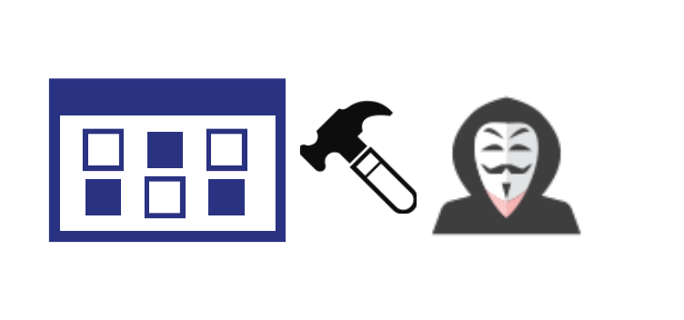
Step 2: Define Attack Strategies
Break In
Attack Option #13:
Data centers can be physically broken into and stolen as any with any computer equipment.

Slide 88
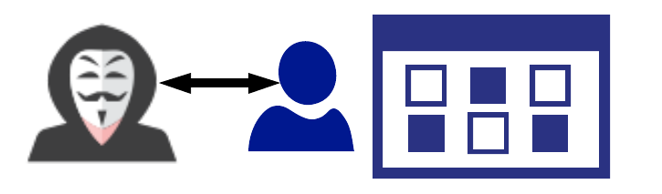
Step 2: Define Attack Strategies
Fake Boss
Attack Option #14:
Database administrators can be socially engineered to provide credentials.

Slide 89
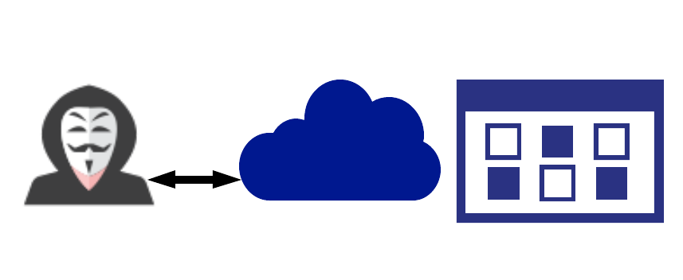
Step 2: Define Attack Strategies
Insecure Cloud Data
Attack Option #15:
Cloud Databases are often improperly secured (with little to no password protection).

Slide 90
Security Challenge #2
Defending the Wall

Slide 91
Form a (new) group of 3-4 students.

Slide 92
Activity: Defending The Wall (15 Minutes)
Assignment:
Now that we’ve assembled a list of potential attacks, your next task is to develop a list of at least 10 strategies to mitigate each of the website’s risks of unauthorized access.
Be Prepared to Share!

Slide 93
Activity: Defending The Wall (15 Minutes)
User Attacks
Web Attacks
Database
Social Engineering
Brute Force Attacks
Physical Break-Ins
Phishing Attacks
Code Injection
Social Engineering
Credential Reuse
Faulty Sessions
Cloud Security
Malware Attacks
Server
Man In the Middle
OS Exploits
To help you out, see this list of identified attacks types
Packet Sniffing
Code Loading
Computer Theft

Slide 94
Security Challenge #2
Defending the Wall (Analyzed)

Slide 95
Step 3: Risk Mitigation Plan
User Attacks
Web Attacks
Database
Social Engineering
Brute Force Attacks
Physical Break-Ins
Phishing Attacks
Code Injection
Social Engineering
Credential Reuse
Faulty Sessions
Cloud Security
Malware Attacks
Server
Man In the Middle
OS Exploits
Risk Mitigation begins by looking at all risks and looking for parallels.
Packet Sniffing
Code Loading
Computer Theft

Slide 96
Step 3: Risk Mitigation Plan
User Attacks
User Risk Mitigation
Educate all users on dangers of phishing and social engineering
Ensure passwords are truly unique to website (require characters atypical of other websites).
Ensure users are using multi-factor authentication (login + phone confirmation).
Ensure administrators can only access the network from a secure location (on premises).
Social Engineering
Phishing Attacks
Credential Reuse
Malware Attacks
Man In the Middle
Packet Sniffing
Computer Theft

Slide 97
Step 3: Risk Mitigation Plan
Web Attacks
Web and Server Risk Mitigation
Ensure passwords used are strong (alphanumeric + symbols).
Ensure login fields do not accept any code insertions.
Ensure users are immediately signed off upon closing a browser. (No preservation of login after 30 seconds of inactivity).
Ensure all servers are routinely patched against latest known vulnerabilities.
Ensure physical access to servers is protected by multiple forms of authentication (login + biometric).
Brute Force Attacks
Code Injection
Faulty Sessions
Server
OS Exploits
Code Loading

Slide 98
Step 3: Risk Mitigation Plan
Database
Database Risk Mitigation
Ensure that all data stored in the database is encrypted and cannot be read without additional credentialling information.
Ensure that all cloud security platforms follow best practices for security implementation.
Physical Break-Ins
Social Engineering
Cloud Security

Slide 99
Step 3: Risk Mitigation Plan
Suggested Plan:
Educate all users on dangers of phishing and social engineering
Ensure passwords are truly unique to website (require characters atypical of other websites).
Ensure users are using multi-factor authentication (login + phone confirmation).
Ensure administrators can only access the network from a secure location (on premises).
Ensure passwords used are strong (alphanumeric + symbols).
Ensure login fields do not accept any code insertions.
Ensure users are immediately signed off upon closing a browser. (No preservation of login after 30 seconds of inactivity).
Ensure all servers are routinely patched against latest known vulnerabilities.
Ensure physical access to servers is protected by multiple forms of authentication (login + biometric).
Ensure that all data stored in the database is encrypted and cannot be read without additional login information.
Ensure that all cloud security platforms follow best practices for security implementation.
As Security Professionals we will make our recommendations based on observed risks and, in conjunction, with our clients make decisions on the best course of action.

Slide 100
Cybersecurity Framework

Slide 101
Our Cybersecurity Framework from Today
Identify Targets
Determine Attacks
Mitigate Risks
Even in our simple exercise, we begin to see an emerging framework for addressing cybersecurity threats

Slide 102
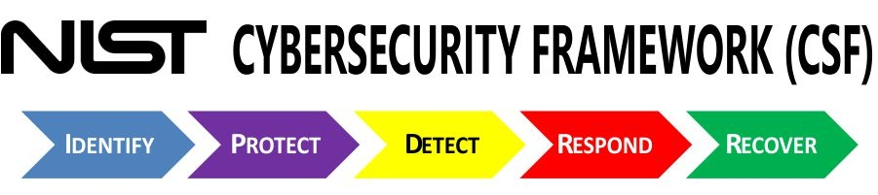
NIST Cybersecurity Framework
As we progress through the class, we’ll begin to understand larger frameworks for addressing cybersecurity threats.

Slide 103
Next Class

Slide 104
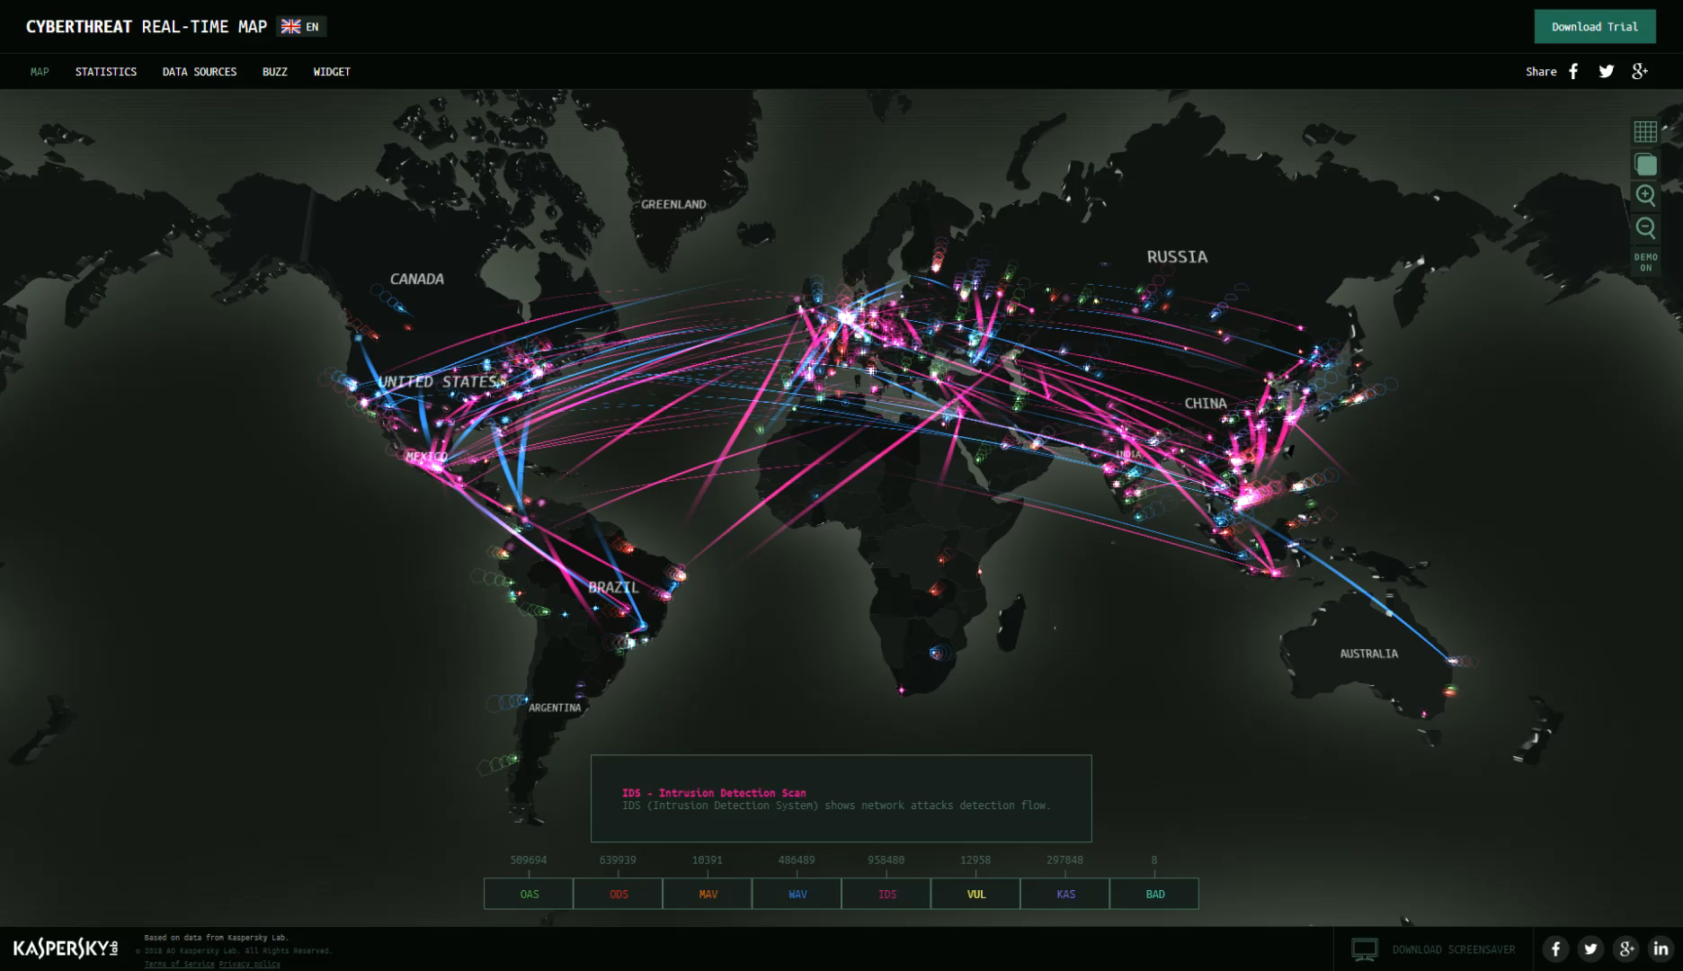
Next class, we’ll dive deeper into today’s threat landscape and talk about the modern day risks we’ll be tasked to handle.

Slide 105
Questions / Discussion

